Slide 1


Introduction To Data Science

Slide 2

Where are we in the journey?
Computer Vision
Applied DS and ML
Deep Learning with NLP
Machine Learning
Python Basics

Slide 3
Takeaways from this Track
Introduction to Data Science
Step into the world of Data Science
Introduction to Machine Learning
Linear and Logistic Regression
Decision tree & Random Forest
Laying down the foundation Data Science
Data Analysis using Python programming
Laying down the foundation of ML
Building the first regression and classification model
Question based approach to prediction

Slide 4
Takeaways from this Track(Machine Learning)
An introduction to ensemble learning
Predict or classify using support vectors
Combining multiple models
Cluster a set of objects based on measure of similarity
Keeping up with latest trends in ML
Boosting
SVM
Stacking
Unsupervised learning
Auto ML & Research Methodology

Slide 5
Takeaways from today’s session
Introduction to Data Science
Step into the world of DS
Introduction to ML
Linear and Logistic Regression
Decision Tree and Random Forest
Boosting
SVM
Stacking
Unsupervised Learning
AutoML and Research Methodology

Slide 6
Takeaways from today’s session
Introduction to Data Science
Real world use cases of Data Science
Data science project lifecycle

Slide 7



How many of you have seen this?

Slide 8


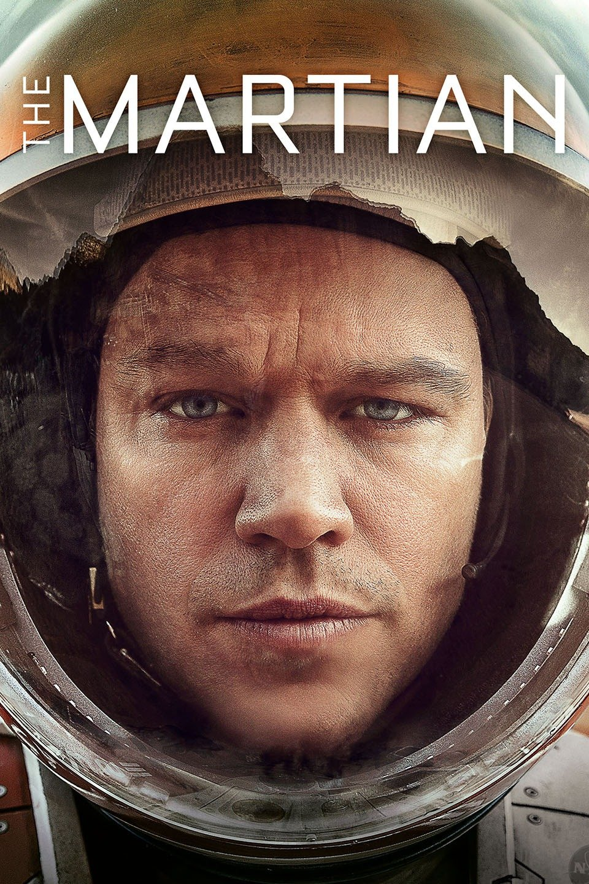
What about this?

Slide 9

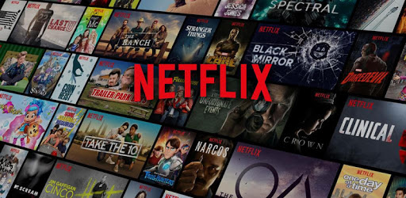
Where have you seen these recommendations?
Netflix takes this a step further by personalizing recommendations

Slide 10
How Netflix uses Data Science?
What is Data Science
How Netflix uses Data Science?
Real world applications of Data Science
Data Science Project Lifecycle

Slide 11
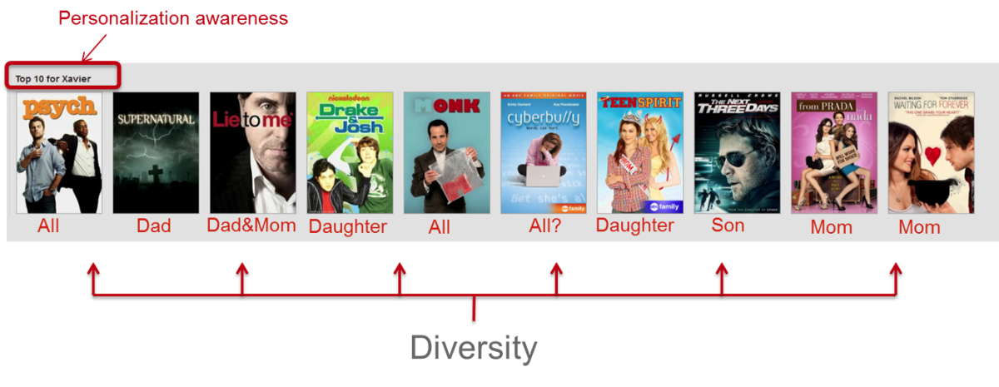
Personalization with diversity
Netflix has adapted personalization algorithms in such a way that now 75% of what people watch is from some sort of recommendation.
The Top 10 row of Netflix which is the best guess at the ten titles you are most likely to enjoy, the recommendations are not only meant for user but also everyone in user’s household.

Slide 12
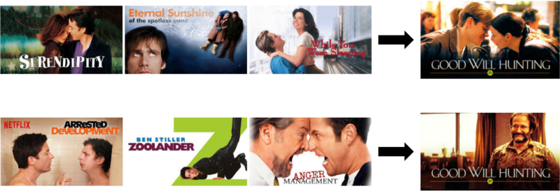
Personalization with different artwork
In Netflix the poster of a movie recommendation changes based on user’s tastes and preferences.
A user who likes genre “Romance” will most likely watch Good Will Hunting with the lead actors featuring in the poster whereas a user who likes genre “Comedy” will most likely watch Good Will Hunting if a well known comedy actor featured in the poster.

Slide 13
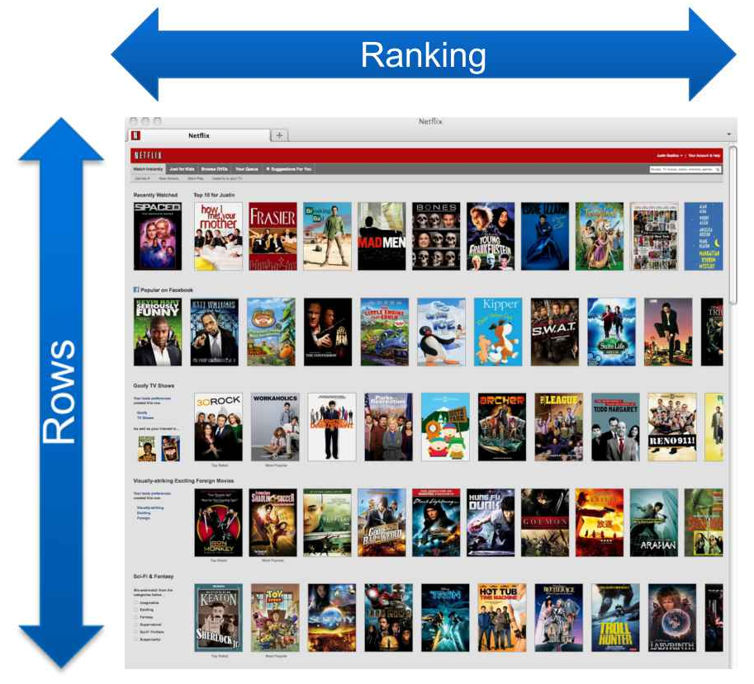
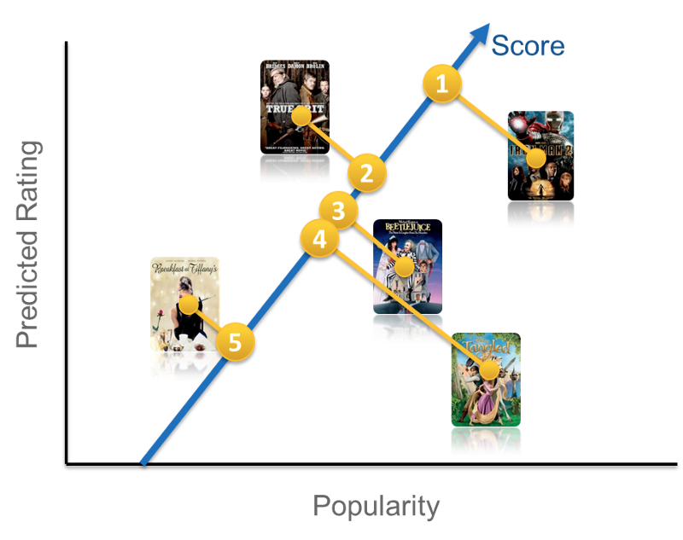
How does Netflix rank movies for viewers?
A simple scoring approach for the ranking function could be a linear combination of popularity and predicted rating
Notes:
let us start with

Slide 14
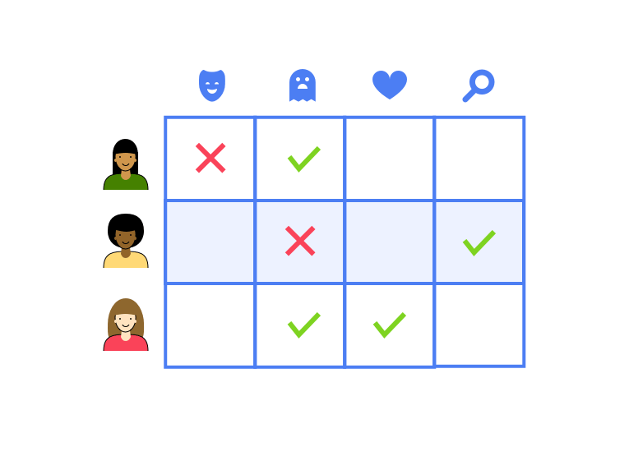
How does Netflix perform recommendations?
Usually recommendation engines, consists of a utility matrix, a probability model which places a score on the relationship between a user and a movie type in order to predict their preferences.
According to this matrix:
User 1 would be recommended with horror movies
User 2 would be recommended with more of light films with comedy and drama
User 3 would be recommended with more niche content like romantic thrillers.
Notes:
let us start with

Slide 15
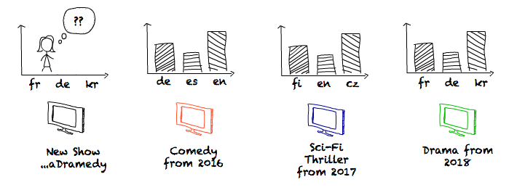
How does Netflix predict the consumption of a show globally?
Netflix predicts the per-language consumption for each show k months before it is released using historical viewing trends.
Notes:
https://medium.com/netflix-techblog/studio-production-data-science-646ee2cc21a1

Slide 16
From these scenarios we understand Netflix’s most valuable resource is:
Data
The science of analysis and generation of insights from data is Data Science
Notes:
Put Netflix engineering blog medium(Netflix blog)

Slide 17
How Netflix uses Data Science?
What is Data Science?
What is Data Science?
Real world applications of Data Science
Data Science Project Lifecycle

Slide 18

What is Data?
Data are raw ingredients from which statistics are created.
Examples of data include a sequence of bits, a table of numbers, the characters on a page, the recording of sounds made by a person speaking, or a moon rock specimen.“

Slide 19





What is Data: Examples
Sequence of bits
Table of Numbers
Characters on a page
Recording of sounds
Moon rock specimen

Slide 20



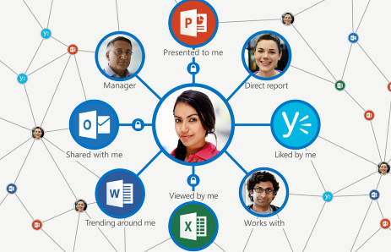
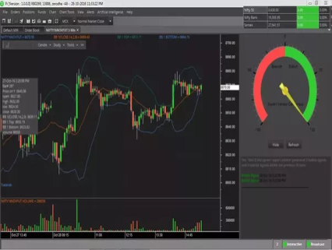


Types of Data
Structured
data
Semi-structured
data
Unstructured
data
Graph
data
Streaming
data

Slide 21





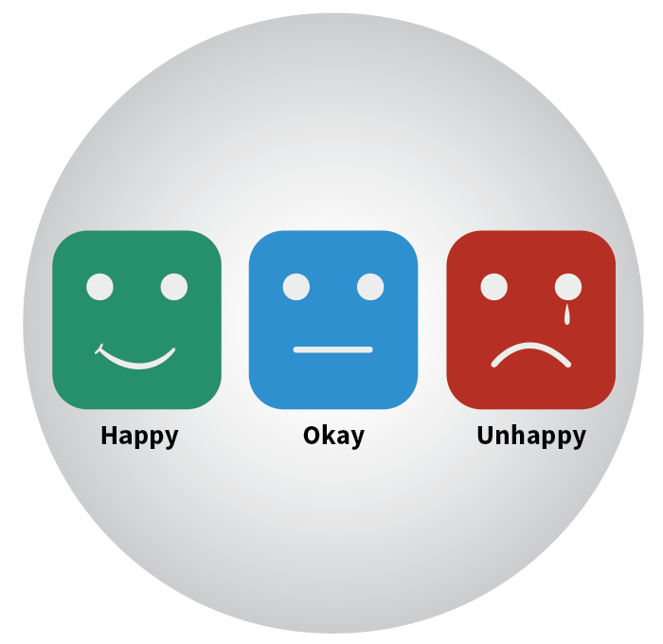


Types of Data: Alternate view
Quantitative
Qualitative
a. Discrete
b. Continuous
a. Nominal
b. Ordinal
Two horses
Height
Male
Female
Customer Service
Interval
Ratio
Time scale
Weight

Slide 22
What is Data Science?

Slide 23
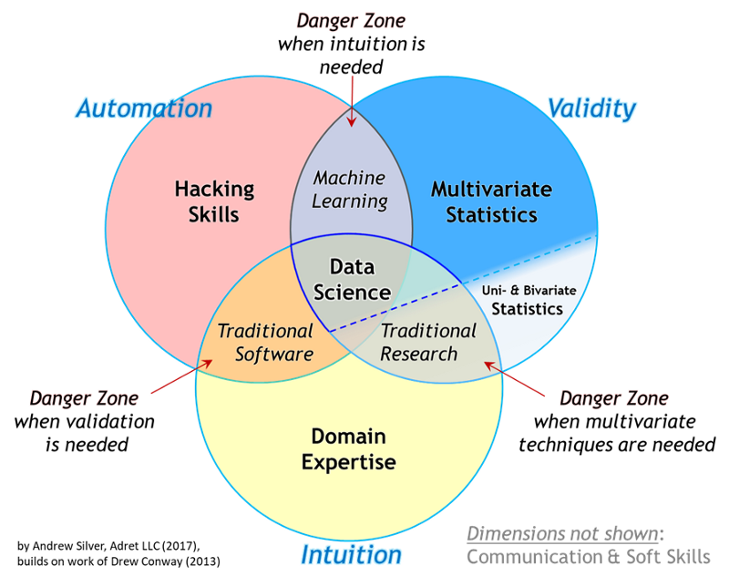
What is Data Science?
Notes:
**new venn diagram to be added (ask Lavi)

Slide 24

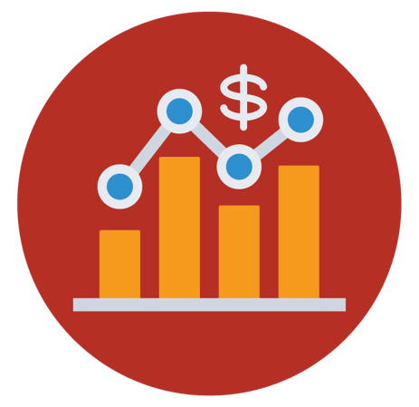

What is Data Science?
Analytics/BI
Data Science(EDA)
Machine Learning
Shows WHAT has happened
Shows WHY it happened
Shows HOW we can predict & automate decision making systems

Slide 25
Who are Data Scientists?

Slide 26
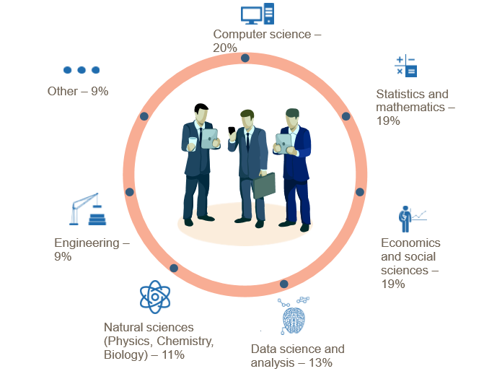
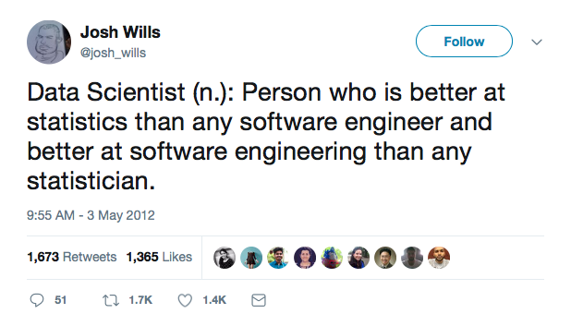
Who is a Data Scientist?
Source: http://wwwis.win.tue.nl/~wvdaalst/data_science/cartoons_New_Breed.jpg

Slide 27
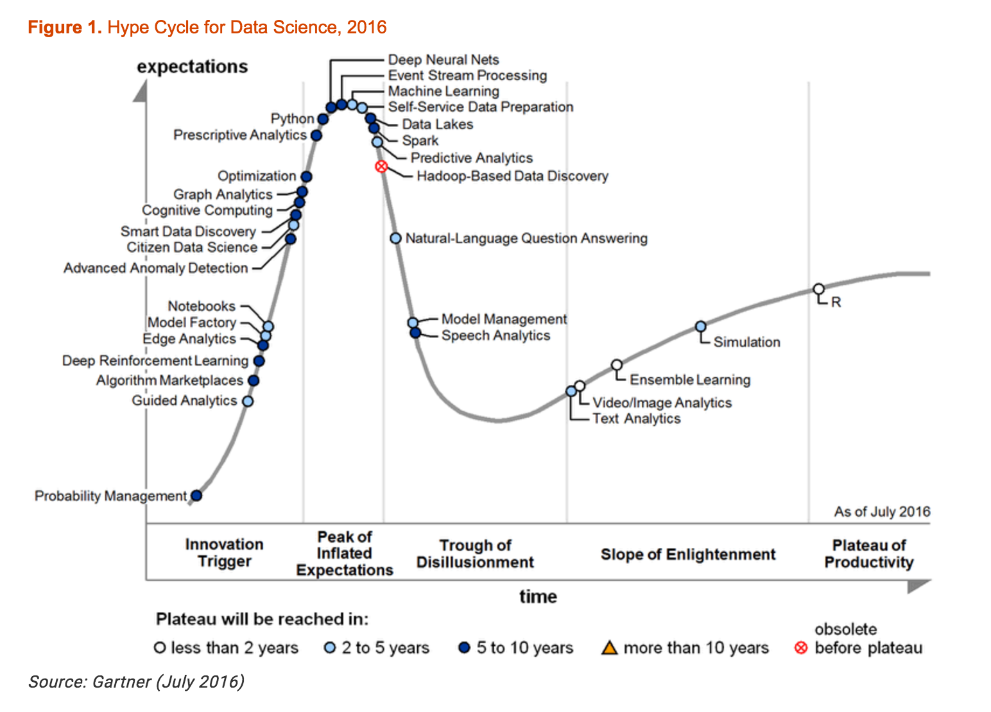
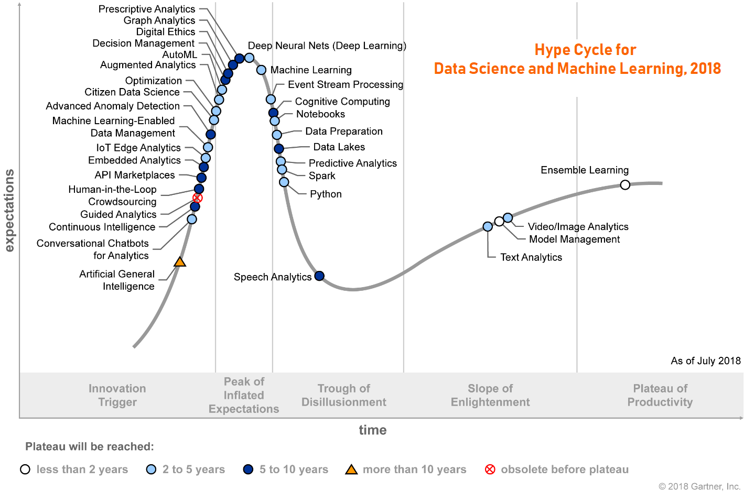
Data Science: Hype or Reality?
Notes:
https://www.linkedin.com/pulse/2018-gartner-hype-cycles-emerging-technologies-data-science-nam-le/

Slide 28
What do Data Scientists do?

Slide 29
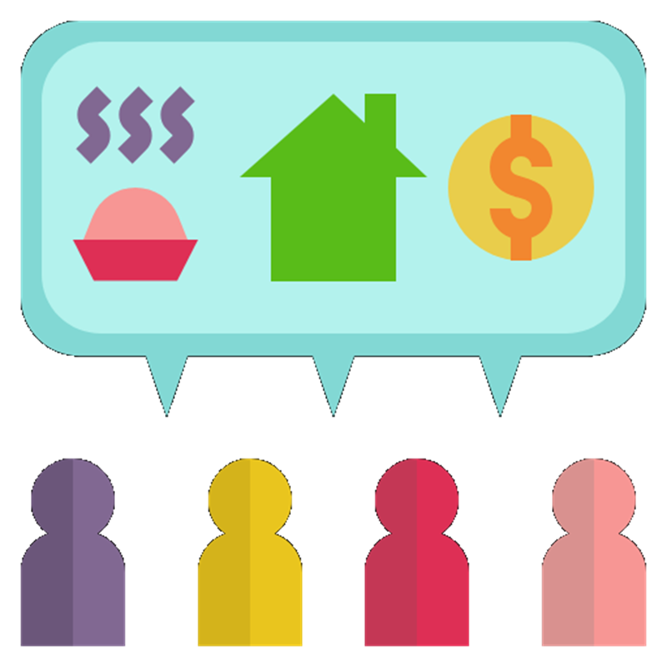
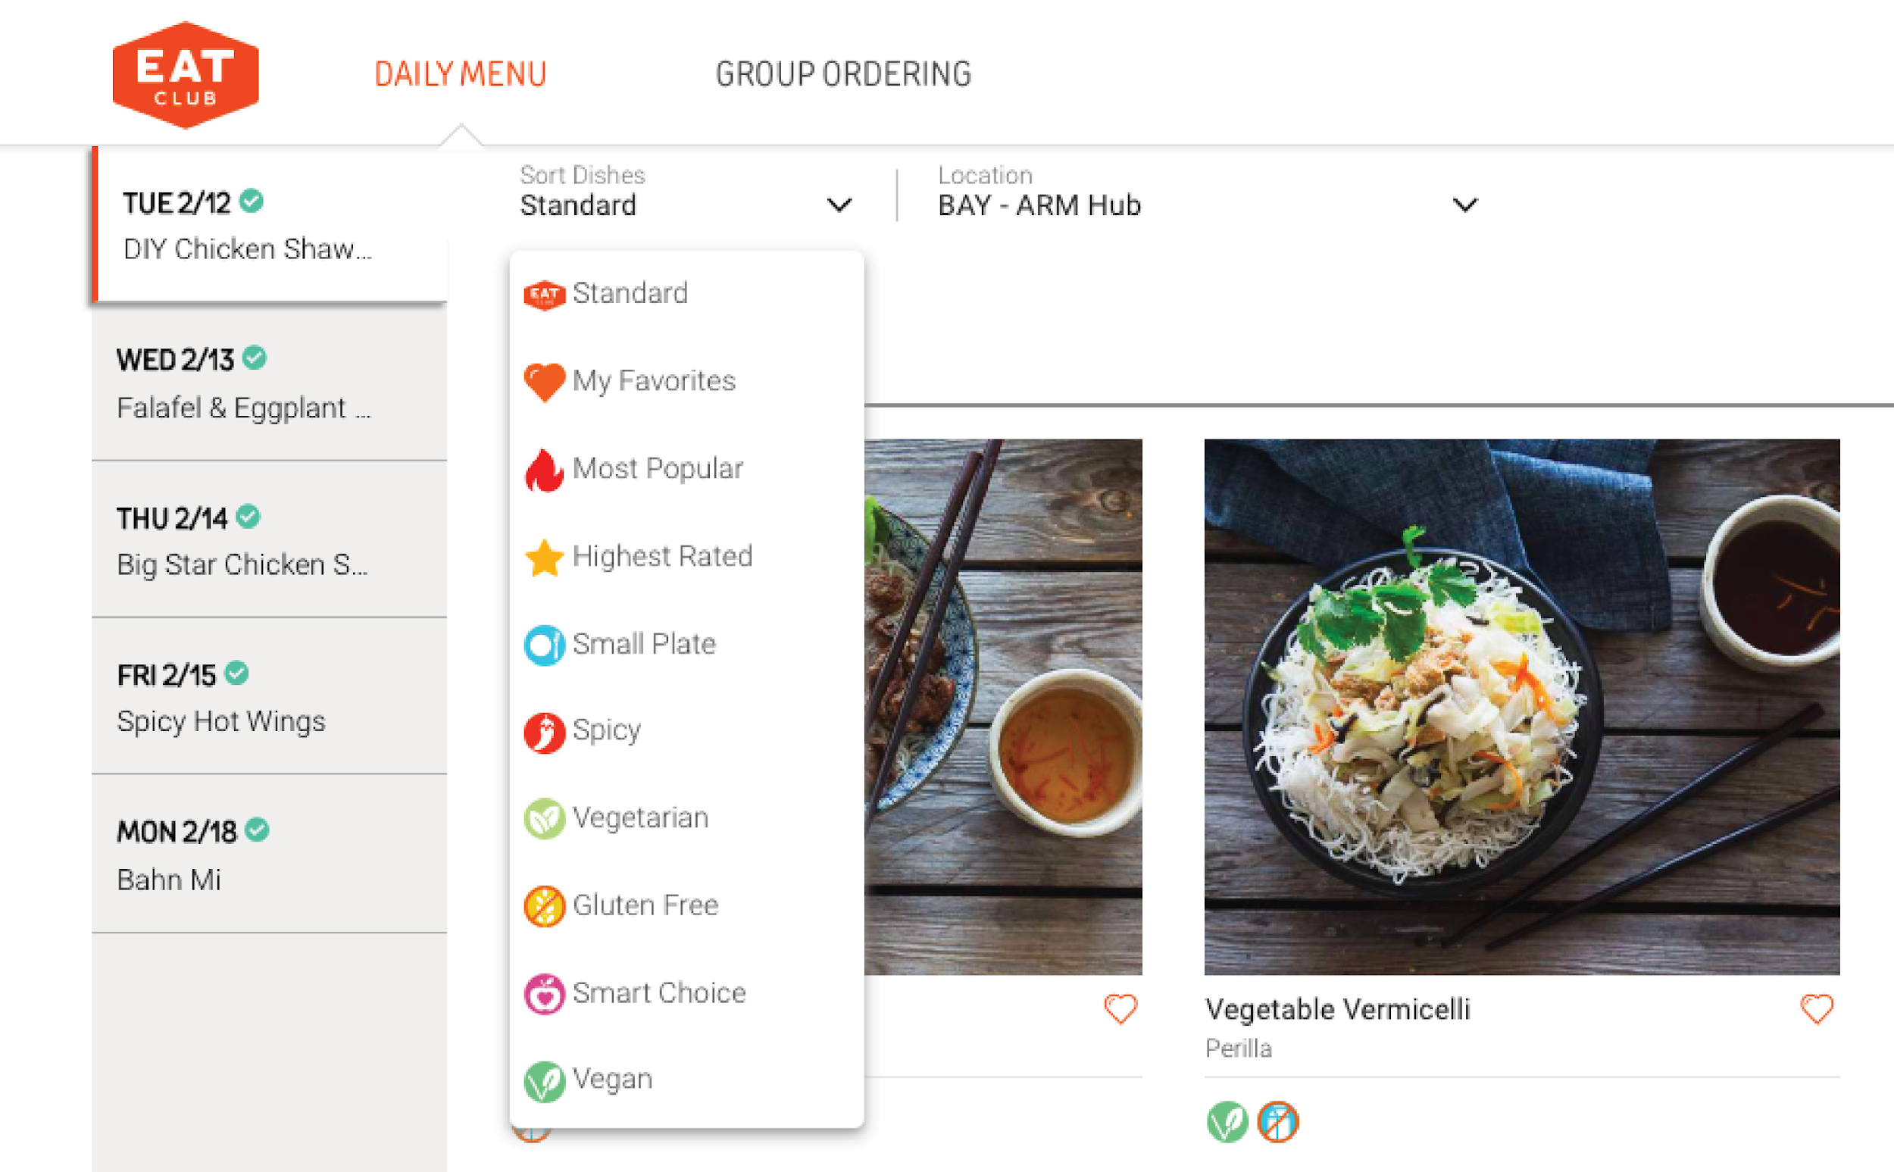


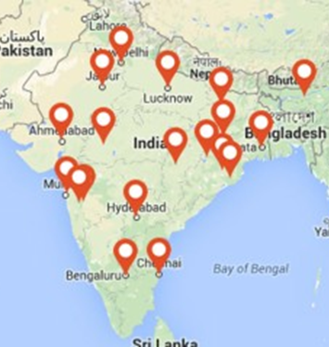
Let’s understand how food delivery apps use data science
To make prediction of demand
Sort customer preferences
To Improve delivery efficiency
To find suitable geographical locations for expansion

Slide 30
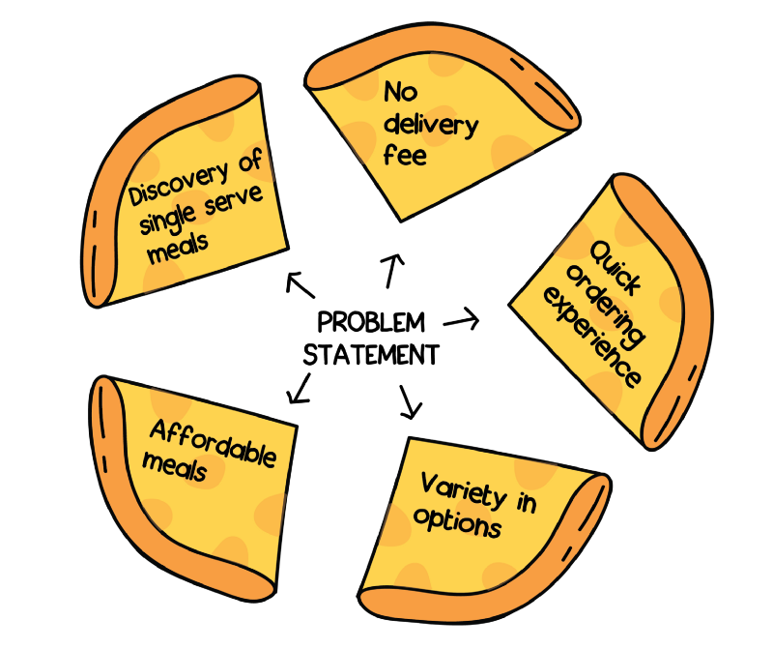
How was Swiggy POP was born?
Problem Statement:
Customers who were ordering food for one person had to go through the pain of choosing from meal options that were usually priced for two.
Delivery fee was high - they didn’t seem to like paying 35 bucks of delivery fee for 100 rupee meal

Slide 31
How was One person meal made affordable?
Data acquisition:
Aim was to find whether there was a market for single serve meals through data by searching for:
item count in a typical Swiggy cart
% of orders which fit into meal-for-one definition
% of orders which fit into meal-for-one definition AND were made from a restaurant offering free delivery
% of order flows which fit into meal-for-one definition BUT had a delivery charge applicable AND were abandoned at the cart
And there was enough data suggesting to solve this single serving meal problem that none of the other competitors had solved
.

Slide 32

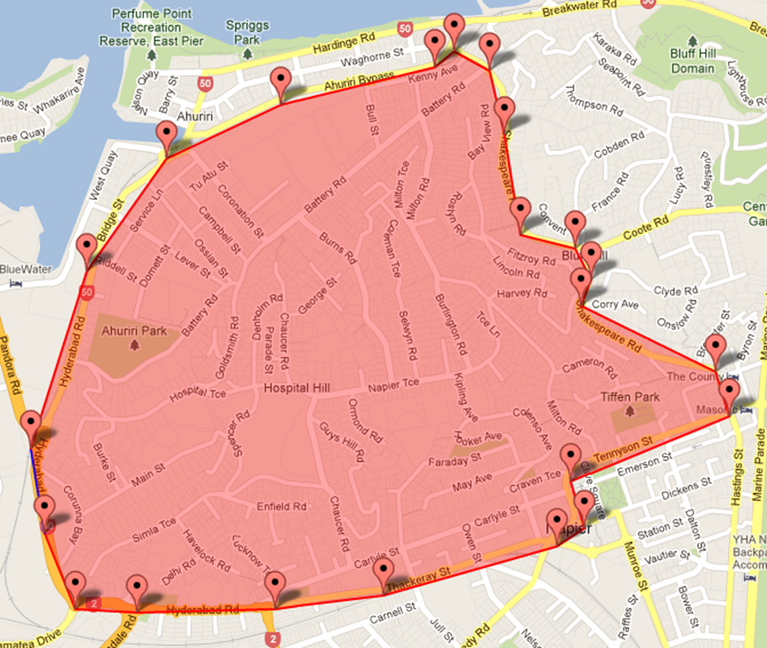
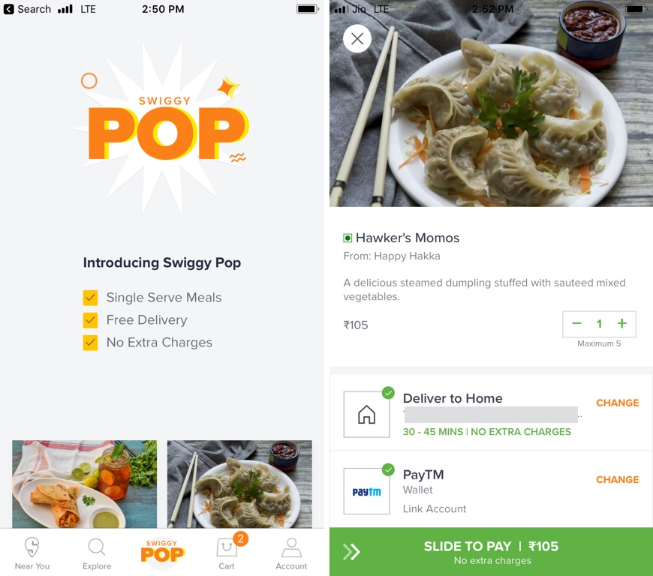


Solution to single serve meals
Make delivery free
Make manual polygons in city such that distance between two farthest points is <3 kms
Make predictable orders so as to reduce restaurant prep time
Enables Lesser delivery time and batch delivery
Pre defined time slots

Slide 33
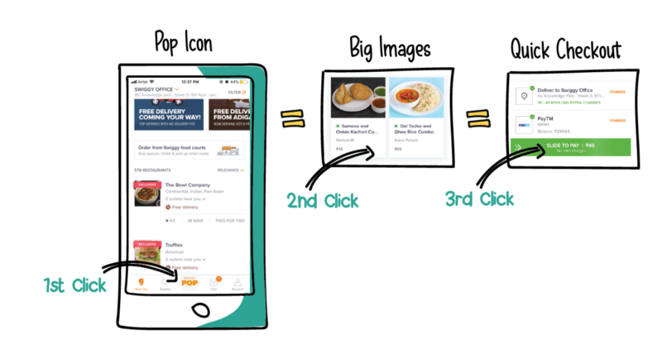
Deployment of Swiggy POP

Slide 34



Let’s understand how ecommerce apps use data science
To predict region wise demand, thus stocking inventory as per the demand
Create algorithms to accurately predict date of delivery by calculating user and product location
Moved from keyword-based search to more semantic-based searches powered by NLP

Slide 35
Deeper Discussions

Slide 36


Data Science: Science or Art?
It is more Art and less Science
Ways in which creativity can be expressed in data science include:
applying techniques in unconventional settings.
combining techniques in unconventional ways.
developing new and unusual hypothesis.

Slide 37




Show me the money!
Why do Data Scientists get paid a lot?
Severe shortage of talent
Directly impact business value
Organizations face enormous data challenges
Need not restricted to Tech Giants anymore
Notes:
https://www.infoworld.com/article/3190008/big-data/3-reasons-why-data-scientist-remains-the-top-job-in-america.html

Slide 38




Good vs Great Data Scientists?
Effective Communication
Intellectual Curiosity
Domain / Industry Knowledge
Analytic Problem-Solving
Notes:
Obvious skills
Maths
Stats
Programming

Slide 39
How Netflix uses Data Science?
What is Data Science
Real world applications of Data Science
Real world applications of Data Science
Data Science Project Lifecycle

Slide 40
Problems that Data Science solves

Slide 41
Problems that Data Scientists solve
Is this A or B?
Is this weird?
How much or how many?
How is this organized?
What should I do now?

Slide 42

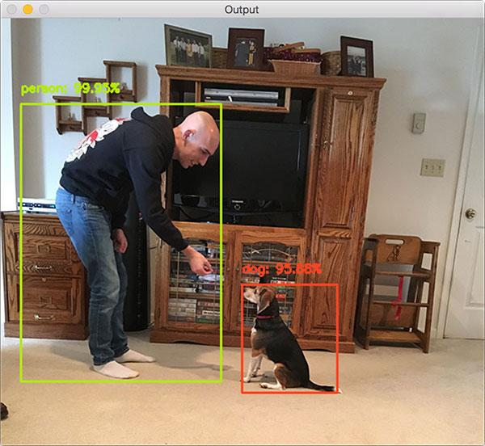
Problems that Data Scientists solve
Is this A or B?
Classification
Will this applicant be able to repay the loan?
Identify a human & a dog?

Slide 43


Problems that Data Scientists solve
Is this weird?
Anomaly
Is this mail in your inbox spam?
Is someone riding bike on a walkway?

Slide 44


Problems that Data Scientists solve
How much or
How many?
Regression
How much will this used car sell for?
Predict how much product sales will be achieved in this month?

Slide 45


Problems that Data Scientists solve
How is this organized?
Clustering
Which viewers like the same kind of movies?
Which pet owner groups have the same purchase behaviour for pet foods?

Slide 46
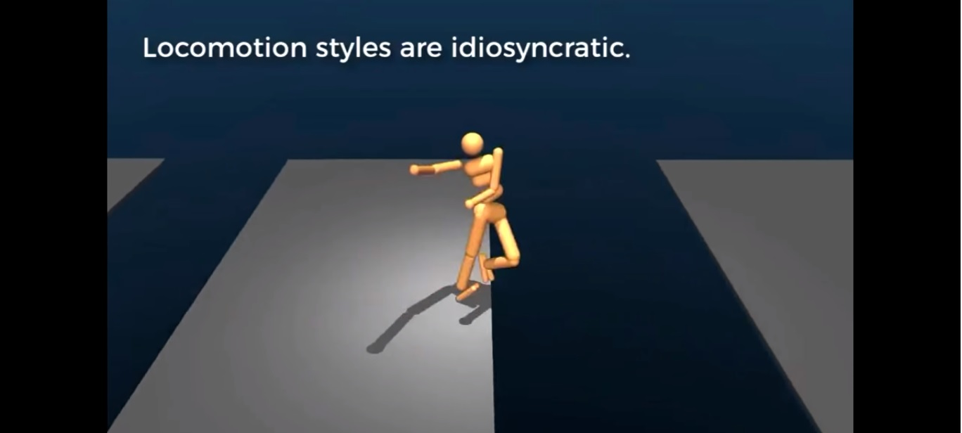

Problems that Data Scientists solve
What should I do now?
Reinforcement learning
How far should the Robot Jump?
Should I break, accelerate, or continue at that yellow light?
Notes:
https://www.youtube.com/watch?v=gn4nRCC9TwQ
Google's DeepMind AI just taught itself to walk

Slide 47
Industry Applications

Slide 48

Applications in Telecom Industry
Customer Acquisition Strategies
Churn Analysis and Control
Up-sell / Cross-sell
Product Bundling

Slide 49
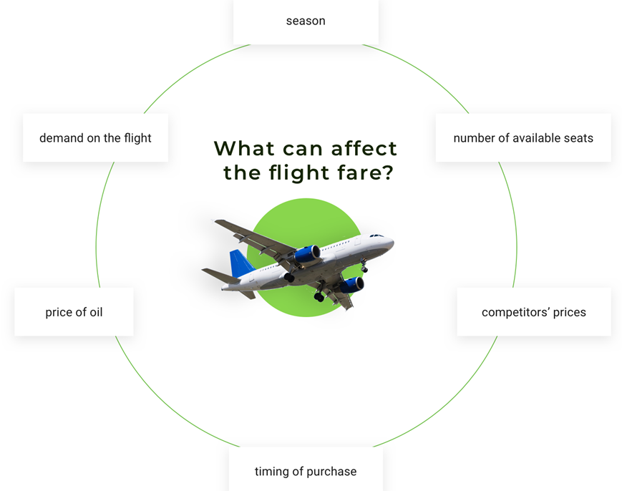
Applications in Travel industry
Predict Flight Delay
Fare estimation using Dynamic Pricing
Airline routes
Effectively Drive Customer Loyalty
Notes:
Through data science flight delays can be predicted using historical data
Dynamic pricing of flights also depend on various external factors like day of booking, how close it is to the departure date, seasonal cycles and so on
Optimize airline routes using machine learning
Improve customer loyalty by offering targeted flight promotional offers

Slide 50

Applications in Healthcare Industry
Clinical trials of new drugs
A / B Testing
Genetics Analysis
Epidemic Forecasting and Control

Slide 51

Applications in Energy and Utilities
Predictive maintenance for machinery
Predict theft and loss prevention
Churn analysis and prevention
Auto balance resources and dynamic routing

Slide 52

Applications in Banking and Finance
Fraud detection and prevention
Customer Segmentation
Risk management
Portfolio Optimization

Slide 53

Applications in Manufacturing
Custom product design
Better quality assurance
Improve manufacturing processes
Managing supply chain risk

Slide 54
How Netflix uses Data Science?
What is Data Science
Data Science Project Lifecycle
Real world applications of Data Science
Data Science Project Lifecycle

Slide 55
Data Science Project Life Cycle

Slide 56
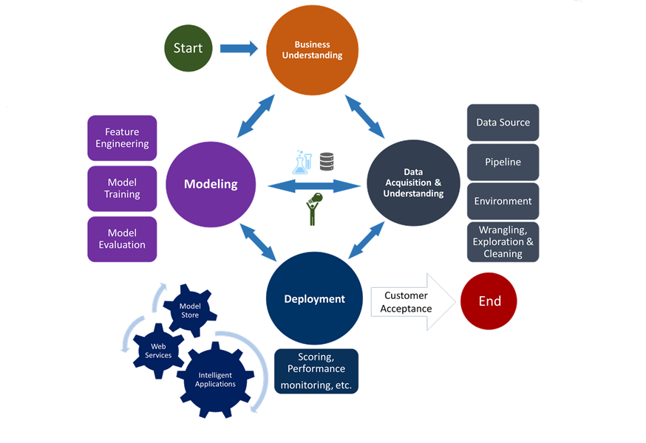
How do I start a Data Science project?
Notes:
**add updated (ask Lavi)

Slide 57



Step 1: Business Understanding
#4
Evaluate & critique model
#5
Present results and document
#3
Build the model
#6 Deploy Model
Deploy the model to solve the problem in the real world
Deploy the model as a product to be used in real world. E.g. Amazon recommendation
Define Objectives
Work with customer and other stakeholders to understand and identify business problems
Business Goals
Formulate questions that define business goals that the data science techniques can target.
Identify data sources
Find the relevant data that helps you answer the questions.
#2
Collect and Manage Data
#7
Continuous improvement process
#1
Define the goal

Slide 58
Step 2: Data Acquisition and Understanding
Data Acquisition and Understanding
Ingest Data
Explore Data
Data Pipeline
Data Pre-processing
Exploratory Data Analysis
Notes:
**add updated (ask Lavi)

Slide 60


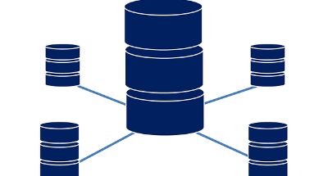

Step 2: Ingest Data
#4
Ingest raw data into your analytic environment once data source is found
Raw data means data that has not been changed since acquisition
This raw data is stored in your storage systems.
Evaluate & critique model
#5
Present results and document
#3
Build the model
#6 Deploy Model
SQL Databases
Hadoop
NoSQL Databases
#2
Collect and Manage Data
#7
Data warehouses
Continuous improvement process
#1
Define the goal

Slide 61

Step 2: Data Pre-Processing
As a Data Scientist, a lot of your time will go in Data pre-processing.
Also known as Data cleaning
This step includes dealing with
Outliers
Missing values
Malicious Data
Erroneous Data
Irrelevant Data
Inconsistent Data
Formatting

Slide 62
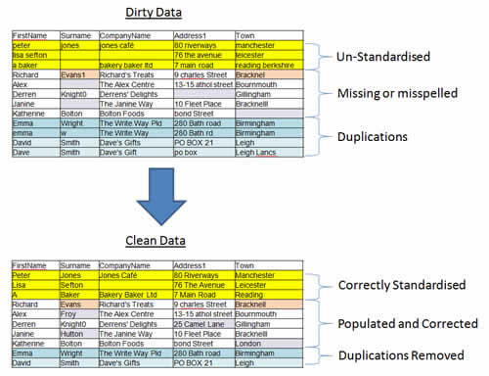
Step 2: Data Pre-Processing – contd..

Slide 63
Step 2: Data Pre-Processing - contd..
Once Data is cleaned, it needs to be processed to make it ready for use.
This stage includes
#4
Sorting
Evaluate & critique model
#3
Build the model
Classification
#6 Deploy Model
Summarization
Deploy the model to solve the problem in the real world
Deploy the model as a product to be used in real world. E.g. Amazon recommendation
#2
Collect and Manage Data
#7
Validation
Aggregation
Continuous improvement process
#1
Define the goal
Data Pre-processing(Data cleaning) is at times considered to be part of Data Processing

Slide 64
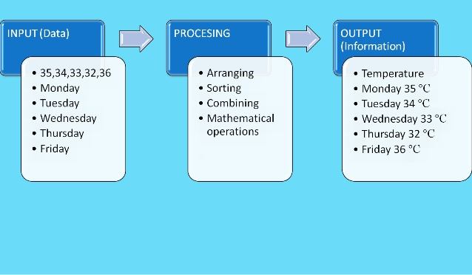
Step 2: Data Pre-Processing - contd..

Slide 65
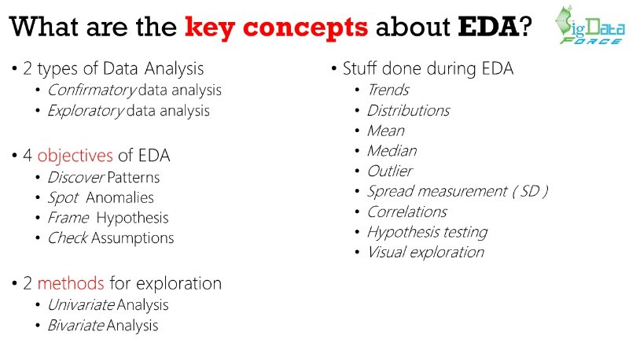
Step 2: Exploratory Data Analysis

Slide 66
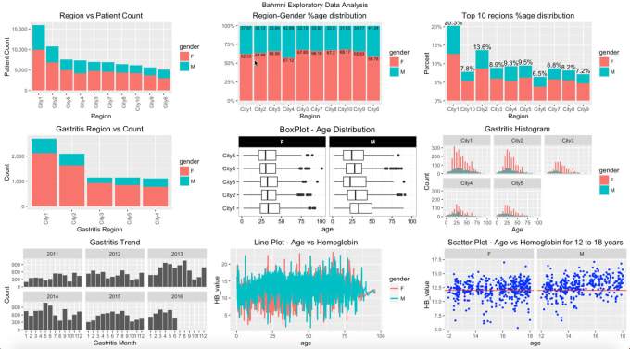
Step 2: Exploratory Data Analysis

Slide 67
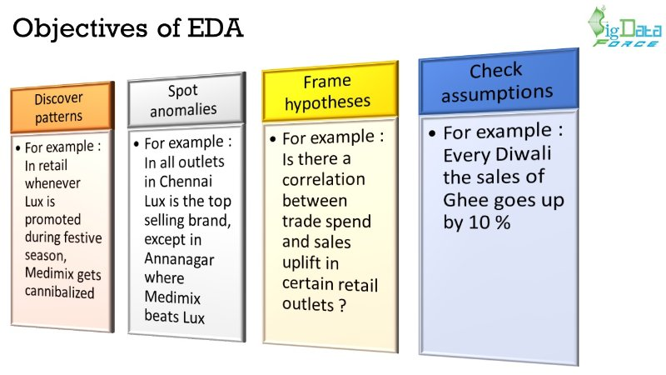
Step 2: Exploratory Data Analysis

Slide 68
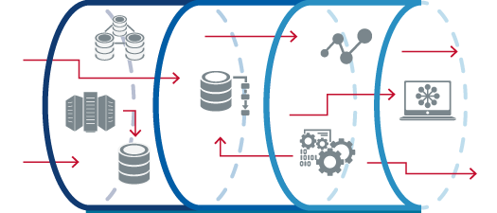
Step 2: Set up a Data Pipeline
Set up a data pipeline that cleans and explores new data as part of an ongoing learning process.
Pipeline can be batch based, streaming(real time) or a hybrid of both.

Slide 69
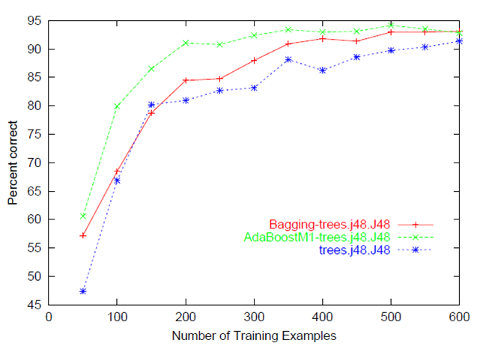
Step 3: Modeling & Algorithms
Split data into train and test
Build multiple models to solve the business problem
Evaluate models using test data and error metrics
Choose “best” model by comparing models to see which one comes closest to answering business objective

Slide 70
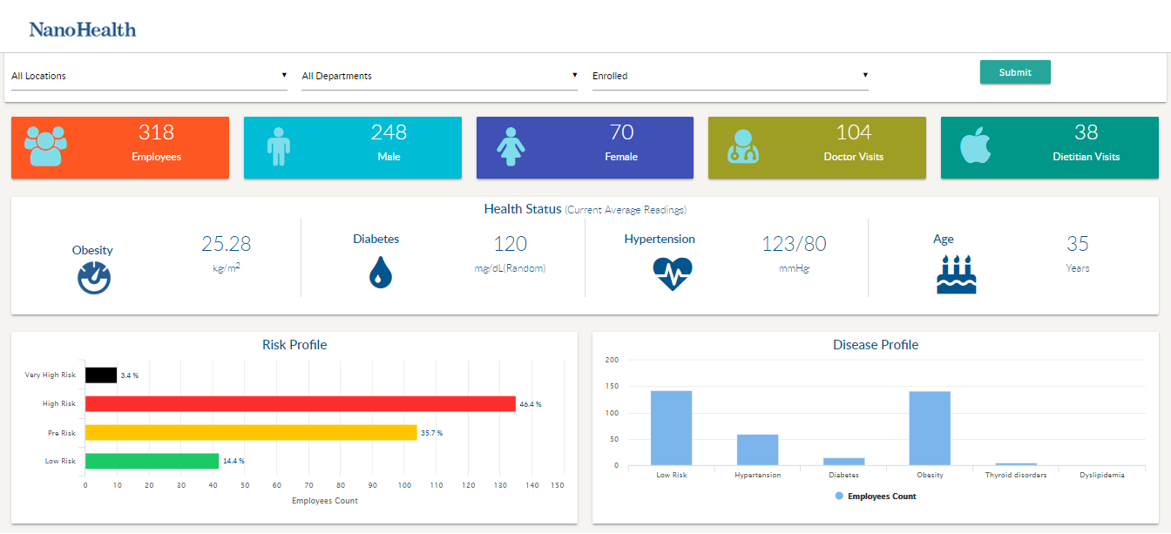
Step 4: Deployment
Seek management’s consideration for deploying the solution to real world to help make the business more optimized and beneficial.
Choose the best performing models and deploy them with an open API interface. The interface enables the model to be easily consumed from various applications, such as
1. Online websites
2. Dashboards
3. Spreadsheets
4. Back-end applications
Notes:
torm with management and showcase the benefit the analysis and models bring to the plate.

Slide 71
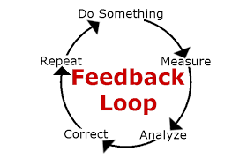
Step 4: Take action & deploy the findings in real world
Deploy the model in production
Measure the metrics
Continue improvement till business goal is achieved
For example, it could be better fraud detection rate, higher upsells through recommendation
Notes:
** Add model explanation,model production

Slide 72

Step 5: Customer Acceptance
System validation: Confirm that the deployed model and pipeline meet the customer's needs.
Project hand-off: Hand the project off to the entity that's going to run the system in production.

